Slide 1
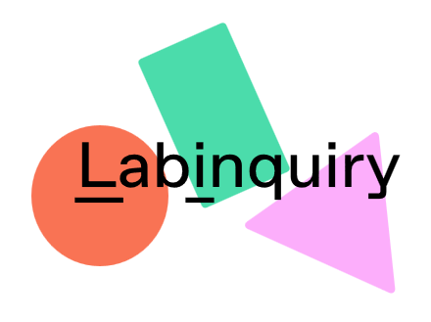

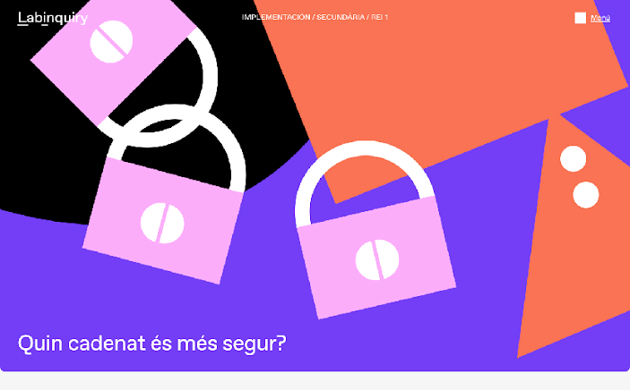
Experience with a learning situation Which padlock is more secure? Academic year 2023-24

Slide 2
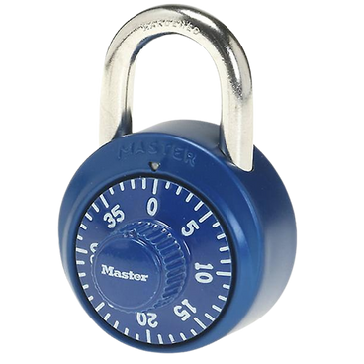
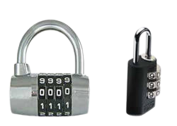
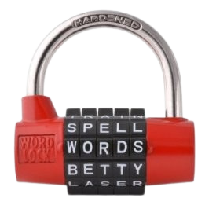
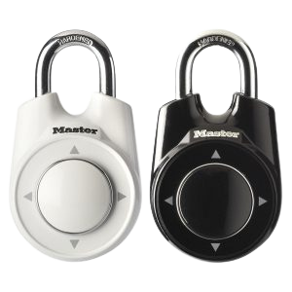
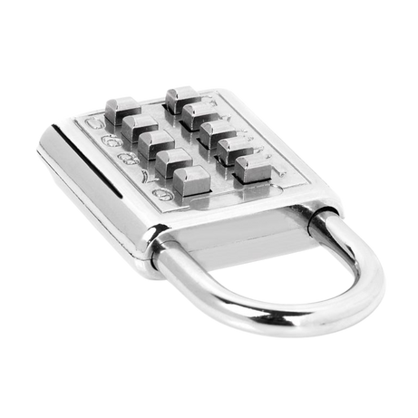
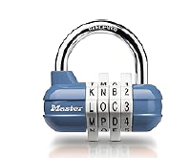
PHASE 0. Generating question and first explorations
Starting question:
Of the following collection of padlocks, which padlock is the most secure?
Notes:
Security depends on the “variants” of each padlock? For example, whether they have letters, symbols, numbers, dates, etc.?
Will the one with the most codes be safer?
Will it depend on the skill of the “thief”?

Slide 4
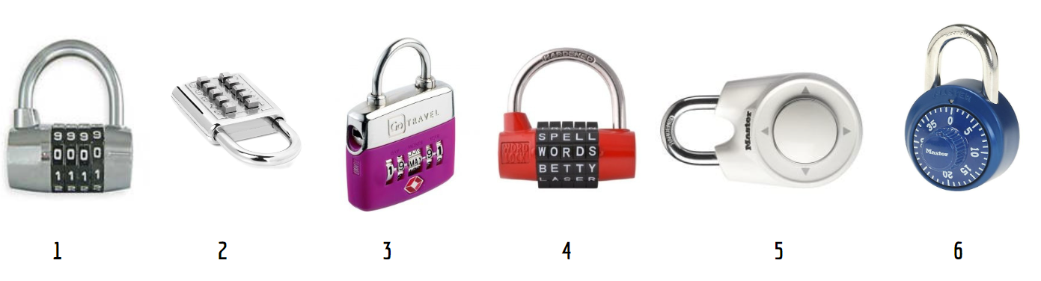
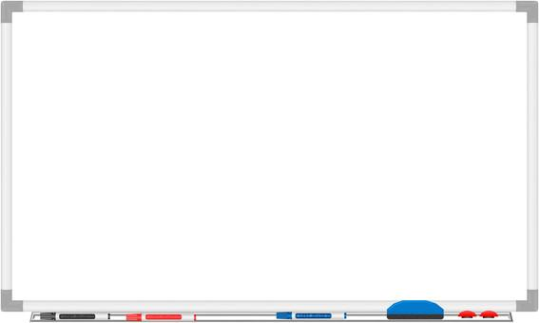
PHASE 0. Generating question and first explorations
Starting question:
Of the following collection of padlocks, which padlock is the most secure?
Collection of the first shower of questions from students...
Notes:
Security depends on the “variants” of each padlock? For example, whether they have letters, symbols, numbers, dates, etc.?
Will the one with the most codes be safer?
Will it depend on the skill of the “thief”?

Slide 5
PHASE 0. Generating question and first explorations
Notes:
Some examples of questions…

Slide 6
PHASE 0. Generating question and first explorations
Security depends on the “variants” of each padlock? For example, whether they have letters, symbols, numbers, dates, etc.?
Will the one with the most codes be safer?
Will it depend on the skill of the “thief”?
It seems that the most secure padlock will be the one with the most codes ...
Q1: How many codes does each padlock support?
Notes:
Some examples of questions…

Slide 7

Let's establish terminology to refer to padlocks
Words to add to the glossary
Code: Possible password that can be entered into the padlock.
Password: Correct code. When we enter it, the padlock opens.
Box: Space (physical or not) in the padlock where the elements of the code are entered.
Code elements : numbers, letters, symbols,... that make up a code.
Example
Code: 0000, 1 234, 2930, 9750 , ... among other possibilities.
Password: 4921 (Because when we enter it, it opens)
Box: It has 4 boxes. Each space where we insert a number between 0 and 9.
Code Elements : Code 1234 has 4 elements: 1, 2, 3 and 4.

Slide 8
PHASE 1. We count codes
Q ₁ : How many different codes does each padlock support?

Slide 9
PHASE 1. We count codes
Q1: How many different codes does each padlock support?
Each working group is responsible for one of the locks.
Padlock 1: Padlock with numeric code
Padlock 2: Push-button padlock
Padlock 4: Word padlock
Padlock 5: Directional padlock
Padlock 6: Safe Padlock
Padlock 7 : Mixed code

Slide 10
PHASE 1. We count codes
Padlock 1: Roulette numbering padlock
You can choose any 4-digit password.
The squares are rotating discs, with 10 numbers ranging from 0 to 9.
Elements or numbers can be repeated.
To open the padlock, the discs must be moved so that the password appears correctly located in each of the 4 boxes.

Slide 11
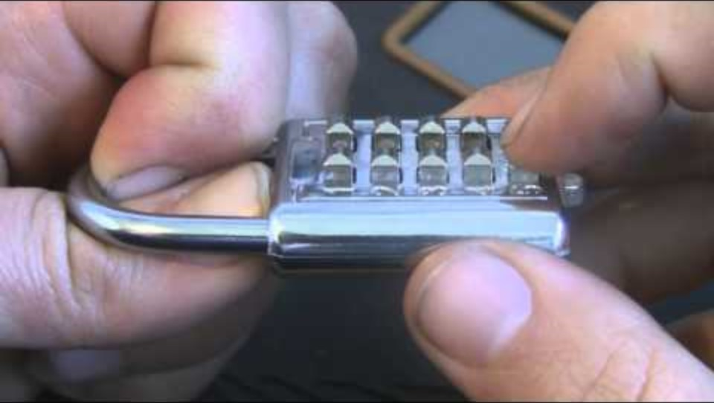
PHASE 1. We count codes
Padlock 2: Push-button padlock
You can choose a 3-digit password.
The padlock does not detect the order in which we press the numbers.
To open it, you must slide the bottom tab.
https://youtu.be/zSUG5iQniSc

Slide 12
PHASE 1. We count codes
Padlock 3 : Word padlock
You can choose any password with 5-letter words.
Only 10 letters are available on each disc.
The padlock has no way of checking whether the word entered makes sense or not. Therefore, the password may be a meaningless word.
There are repeated lyrics on the different albums.
To open it, the discs must be moved so that the password appears in the position next to the tab.

Slide 13
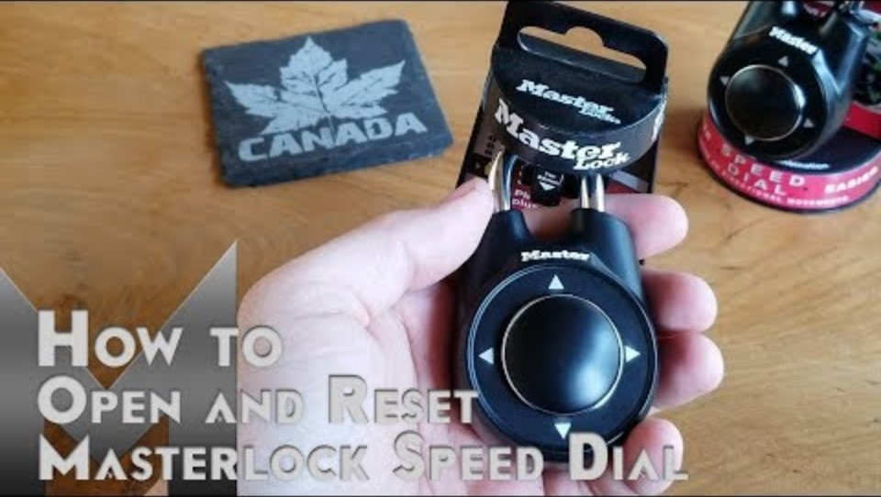
PHASE 1. We count codes
Padlock 4 : Directional padlock
Any 4-direction password can be chosen (up, down, right, left)
A password can have repeated elements.
To enter a new password, you must press twice against the padlock.
When the code is correct, the padlock can be opened.
https://youtu.be/9IAfqFGM56w?t=153

Slide 14
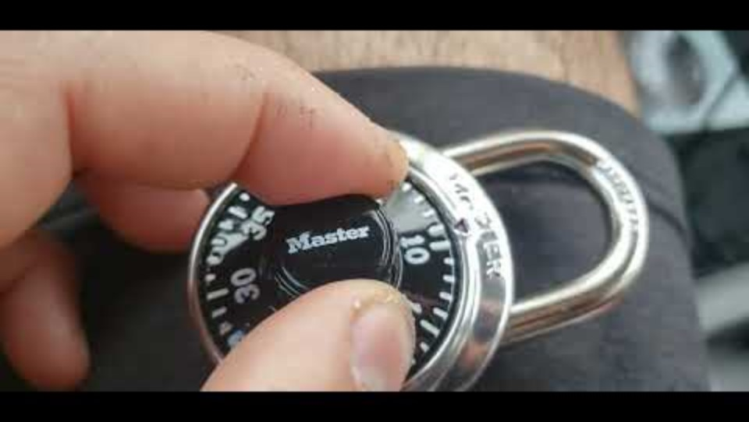
PHASE 1. We count codes
Padlock 5 : Safe Padlock
You can choose any password with 3 numbers, between 0 and 39.
Password supports repeated digits
To enter the password: watch the video
https://youtu.be/ednwKwSu7dw

Slide 15
PHASE 1. We count codes
Padlock 6 : Padlock with numbers, letters and special characters
You can choose any password with 4 numbers, letters and special characters.
Password supports repeated elements
Only 10 items are available on each disc.
There are repeated elements on the different discs.
To open it, the discs must be moved so that the password appears in the position next to the tab.

Slide 16
PHASE 1. We count codes
Q ₁ : How many different codes does each padlock support?

Slide 17
PHASE 1. We count codes
Sharing the answers found in Q1

Slide 18
PHASE 1. We count codes
Sharing the answers found in Q1
There are equivalent padlocks
There are difficult padlocks to enter the codes.
Number of codes supported:
10,000 – 175 – 48,000 – 100,000 – 256 – 59,280

Slide 19
PHASE 1. We count codes
Sharing the answers found in Q1
Q1.1. What is the maximum time it would take to open each padlock?
Q1.2. Does security depend only on the number of codes?
Q1.3. What small modification could we make to each padlock to make it more secure?
10h – 8min – 30h – 50h – 42min – 80h

Slide 20
PHASE 2. Validation with the padlock collection with restrictions
What answers and new questions have we gathered from the study prepared by the different groups on...
Q ₁ : How many different codes does each padlock support?

Slide 21
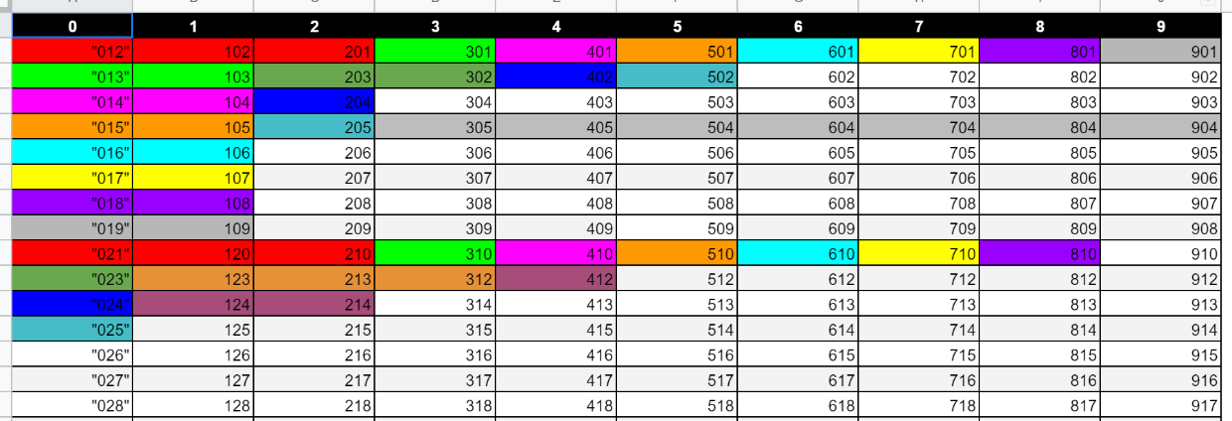
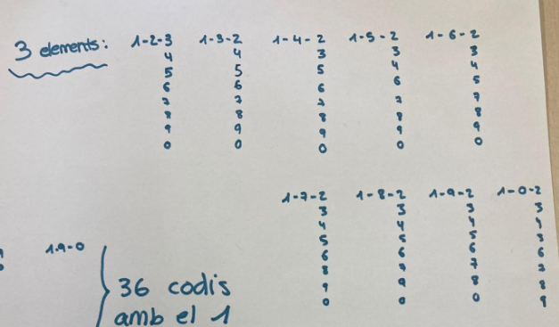
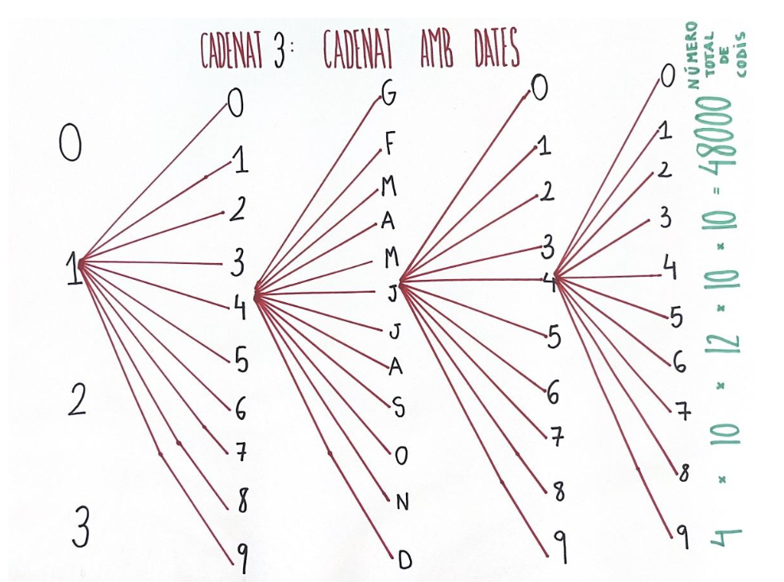
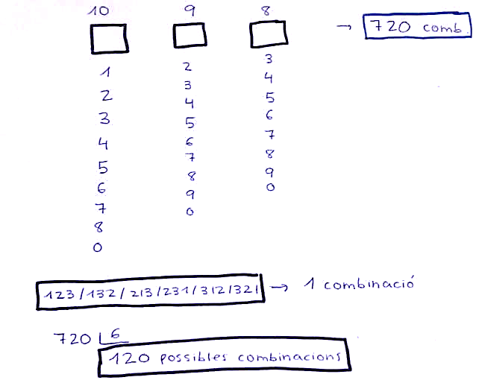
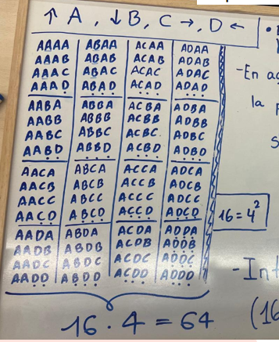
PHASE 2. Validation with the padlock collection with restrictions
We name the different techniques for describing the space to be counted.
More or less structured lists of codes
Tree diagram

Slide 22
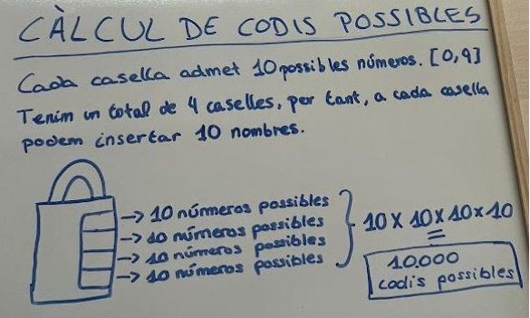
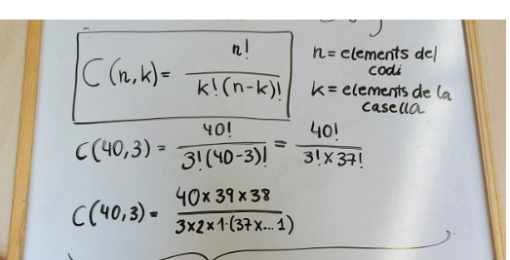
PHASE 2. Validation with the padlock collection with restrictions
Let's name the different techniques for counting codes
Options product
Grouping
of repeated codes
Formula search and use

Slide 23
PHASE 2. Validation with the padlock collection with restrictions
We've been given more information about the password...
Q ₂ : Can we find the number of codes the padlocks now have with the new information?

Slide 24
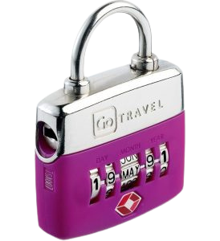
PHASE 2. Validation with the padlock collection with restrictions
Padlock 7: Roulette numbering padlock (no repeats)
We know that the password does not contain repeated digits
Padlock 10: Directional padlock (no repetitions)
We now know that the password does not contain repeated addresses
Padlock 8: Push-button padlock (extended)
We know for sure that the password has 4 digits.
Padlock 11: Safe padlock (with repetitions)
Padlock 9: Date padlock (no repeats)
We know that the password has two repeated digits
We know that neither days nor years contain repeated numbers.

Slide 25
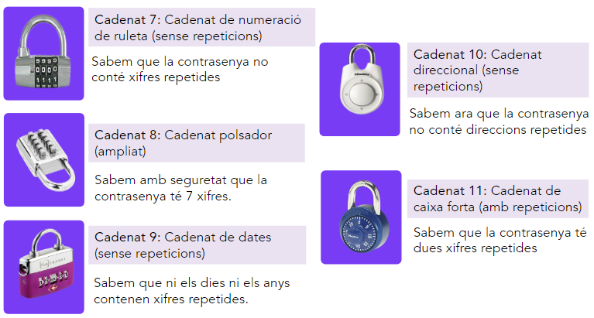
PHASE 2. Validation with the padlock collection with restrictions
PART 1. GROUP WORK
Can you calculate the number of passwords for each padlock?
If not, ask questions for the groups responsible for each type.

Slide 26
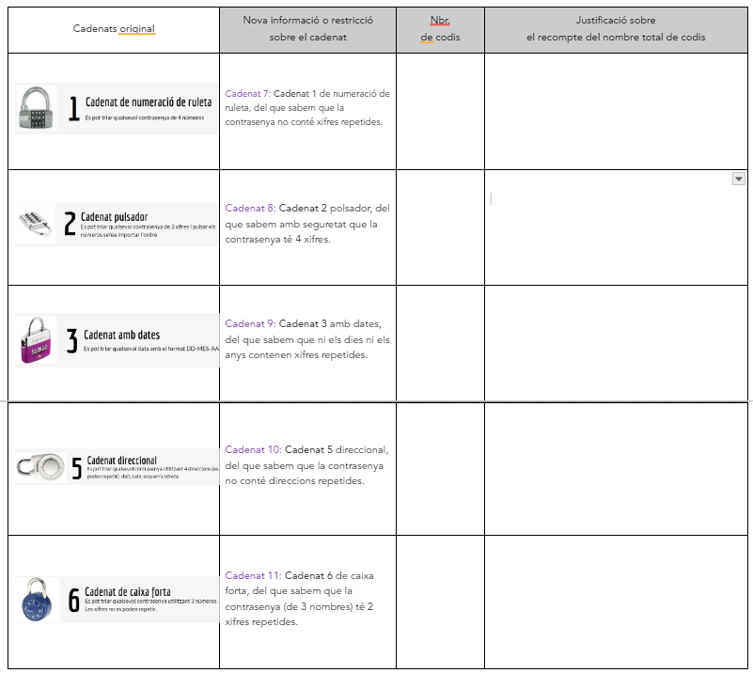
PHASE 2. Validation with the padlock collection with restrictions
PART 2. INDIVIDUAL WORK
Indicate the number of passwords for each new type of padlock and justify your answer.

Slide 27
PHASE 3. Classification of padlocks and general techniques
Q ₃ : What characterizes a padlock model?
What models are there?
How do we characterize and name them?

Slide 28
PHASE 3. Classification of padlocks and general techniques
PART 1. GROUP WORK
Work with your group to propose possible classifications of padlocks by explaining:
What characterizes a model or type or class of padlock?
Why did you decide to group them into the same type?
How to characterize the same type or model of padlock? What can we call them?

Slide 29
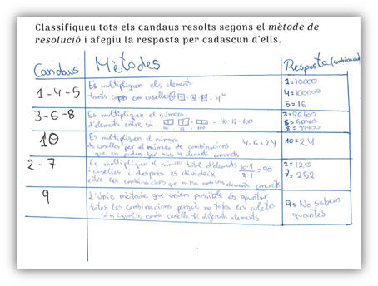
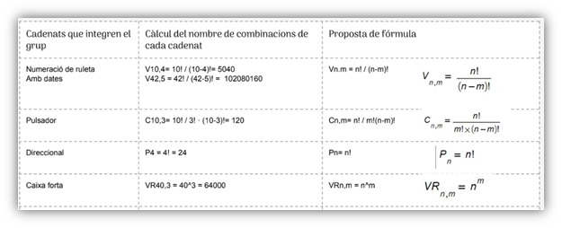
PHASE 3. Classification of padlocks and general techniques
PART 2. SHARING
Teachers guide the sharing of ideas between the different groups on Q3. See examples below:

Slide 30
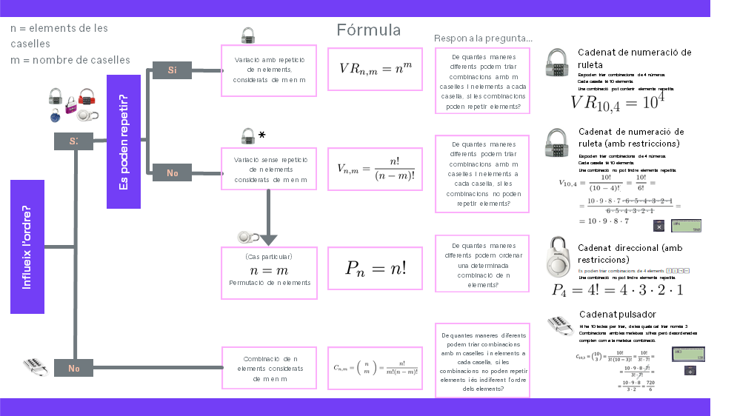
PHASE 3. Classification of padlocks and general techniques

Slide 31
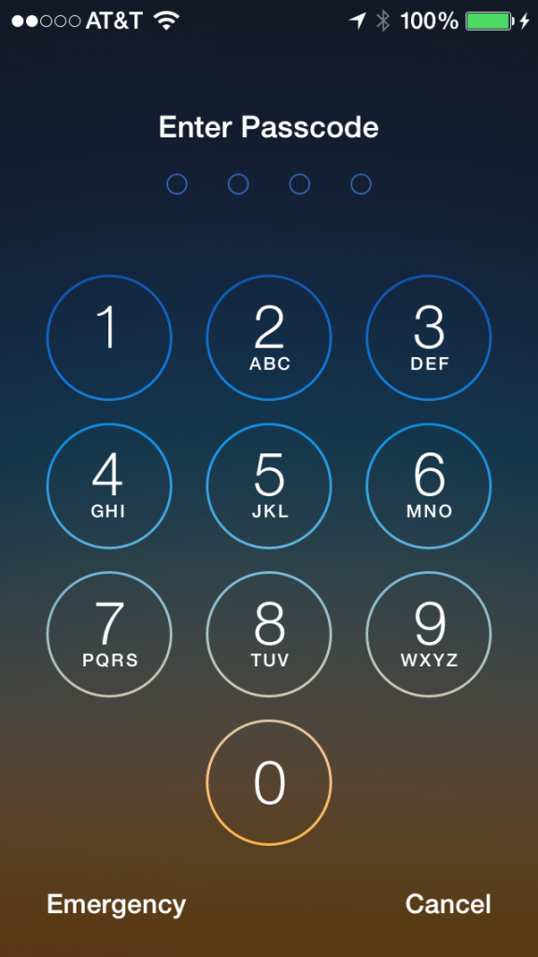
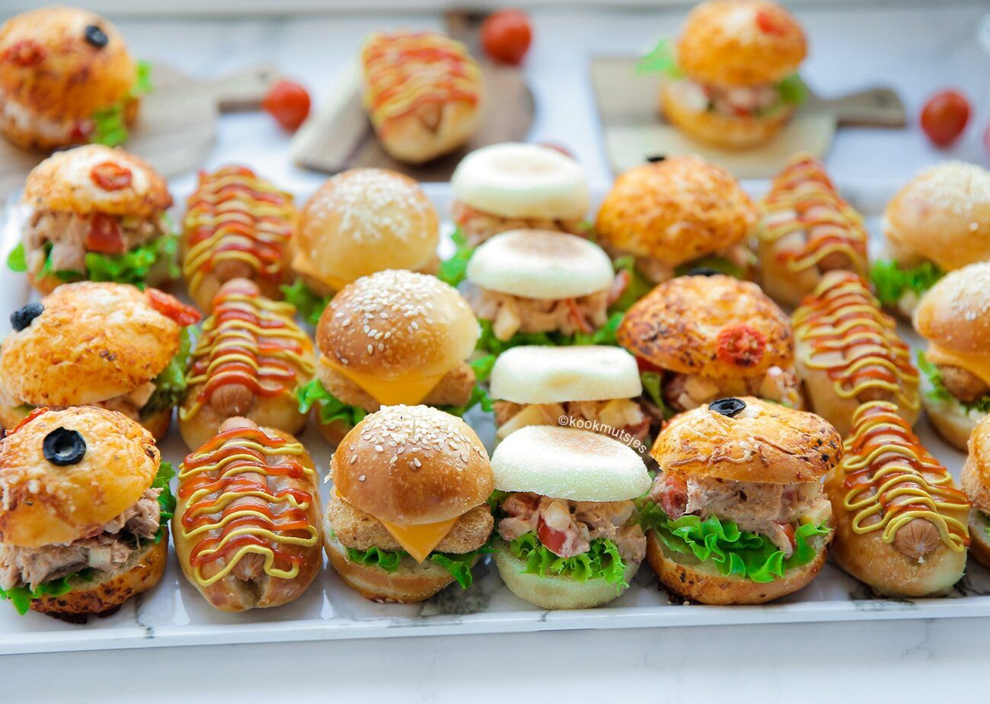
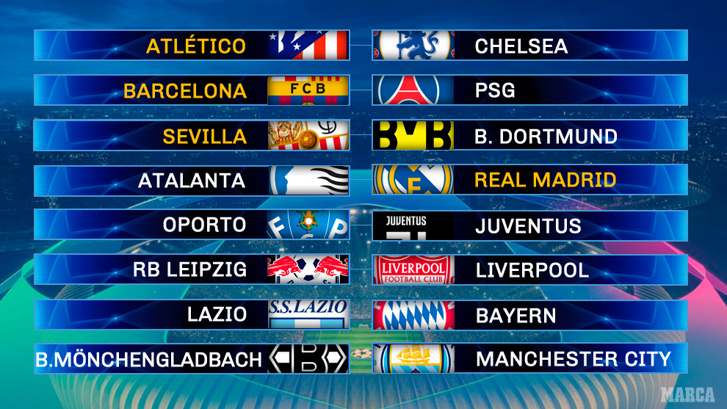
PHASE 4. Beyond the Padlocks
Q ₄ : Do these models work to solve more counting problems?
in different contexts that of padlocks?

Slide 32
PHASE 4. Beyond the Padlocks
Q 4 : Do these models work to solve more counting problems in contexts other than padlocks?
Choose a 4-digit mobile phone pin number?
Making football match crosses if there are 20 teams and everyone has to play against everyone in the first and second leg?

Slide 33
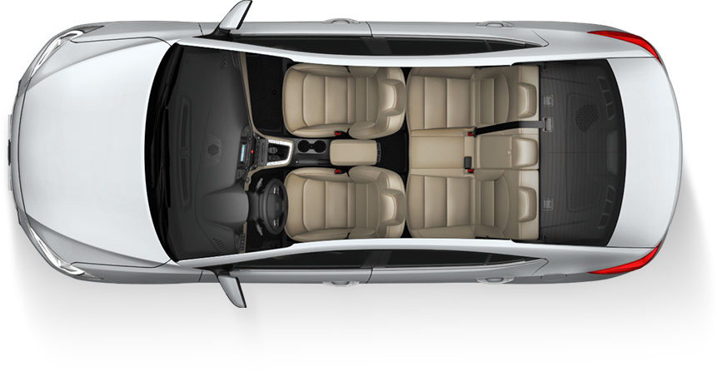
PHASE 4. Beyond the Padlocks
Q 4 : Do these models work to solve more counting problems in contexts other than padlocks?
Making 5 friends sit in a car if 2 of them have a license?
Ways to choose 3 different sandwiches from a total of 6 types of sandwiches?

Slide 34
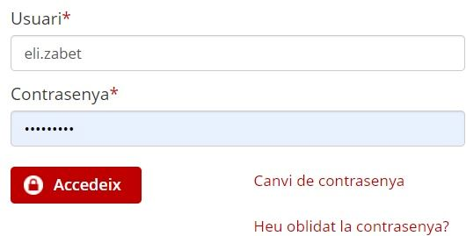
PHASE Optional. Let's be hackers!
Q ₃ : How to create secure passwords?

Slide 35
PHASE Optional. Let's be hackers!
Let's compare passwords
When we have to create passwords, we find different instructions depending on the application or website.
Which ones do you think are safer? Why?
MOBILE PUK 8 numbers
GMAIL 8 elements minimum with uppercase, lowercase letters, numbers and special characters (as desired)
INSTITUTE MAIL 8 elements minimum, alphanumeric, at least one capital letter and one special character
CHILDREN'S MAIL 8 elements, 4 capital letters followed by 4 numbers
BANK PIN 8 lowercase letters
DISCUSS IT IN THE GROUP AND LET'S PREPARE A COMMON POSITION

Slide 36
PHASE Optional. Let's be hackers!
How to create a secure password?
When we have to create passwords, we find different instructions depending on the application or website.
Which ones do you think are safer? Why?
MOBILE PUK 8 numbers
GMAIL 8 elements minimum with uppercase, lowercase letters, numbers and special characters (as desired)
CHILDREN'S MAIL 8 elements, 4 capital letters followed by 4 numbers
INSTITUTE MAIL 8 elements minimum, alphanumeric, at least one capital letter or a special character
PROFESSIONAL MAIL 8 elements minimum, alphanumeric, 2 numbers, 2 lowercase letters, 1 uppercase letter, special character if desired
BANK PIN 8 lowercase letters
DISCUSS IT IN THE GROUP AND LET'S PREPARE A COMMON POSITION
Notes:
Alternative if you want to include the XTEC case

Slide 37
PHASE Optional. Let's be hackers!
Sharing the first ideas about Q3

Slide 38
PHASE Optional. Let's be hackers!
Ideas for managing the end of the sharing:
Limit passwords to 8 elements (to make it easier). Later you can see how security varies when we increase the number of elements.
It is easy to calculate the simplest cases: PUK, CHILD and Bank PIN.
Calculating the total of the others is too difficult. You can do some examples with CORREU INSTITUT where you have to distinguish the order of the numbers and the letters: 1234ABCD is not the same as ABCD1234.
We look for other strategies to compare:
If we can make all the passwords for another case with one, we keep that one. If we can't, we see if we can make more (for example, because there are more letters than numbers).
GROUP WORK PROPOSAL: compare the 5 cases.

Slide 39
PHASE Optional. Let's be hackers!
Sharing the comparison between passwords
ORDER PASSWORDS FROM LEAST TO MOST SECURE
MOBILE PUK 8 numbers
INSTITUTE MAIL 8 elements minimum, alphanumeric, at least one capital letter or a special character
GMAIL 8 elements minimum with uppercase, lowercase letters, numbers and special characters (as desired)
CHILDREN'S MAIL 8 elements, 4 capital letters followed by 4 numbers
BANK PIN 8 lowercase letters
PREPARE A PRESENTATION WITH PROPOSALS ON THE INSTITUTE'S EMAIL PASSWORD: IS IT SECURE ENOUGH? CAN IT BE IMPROVED?

Slide 40
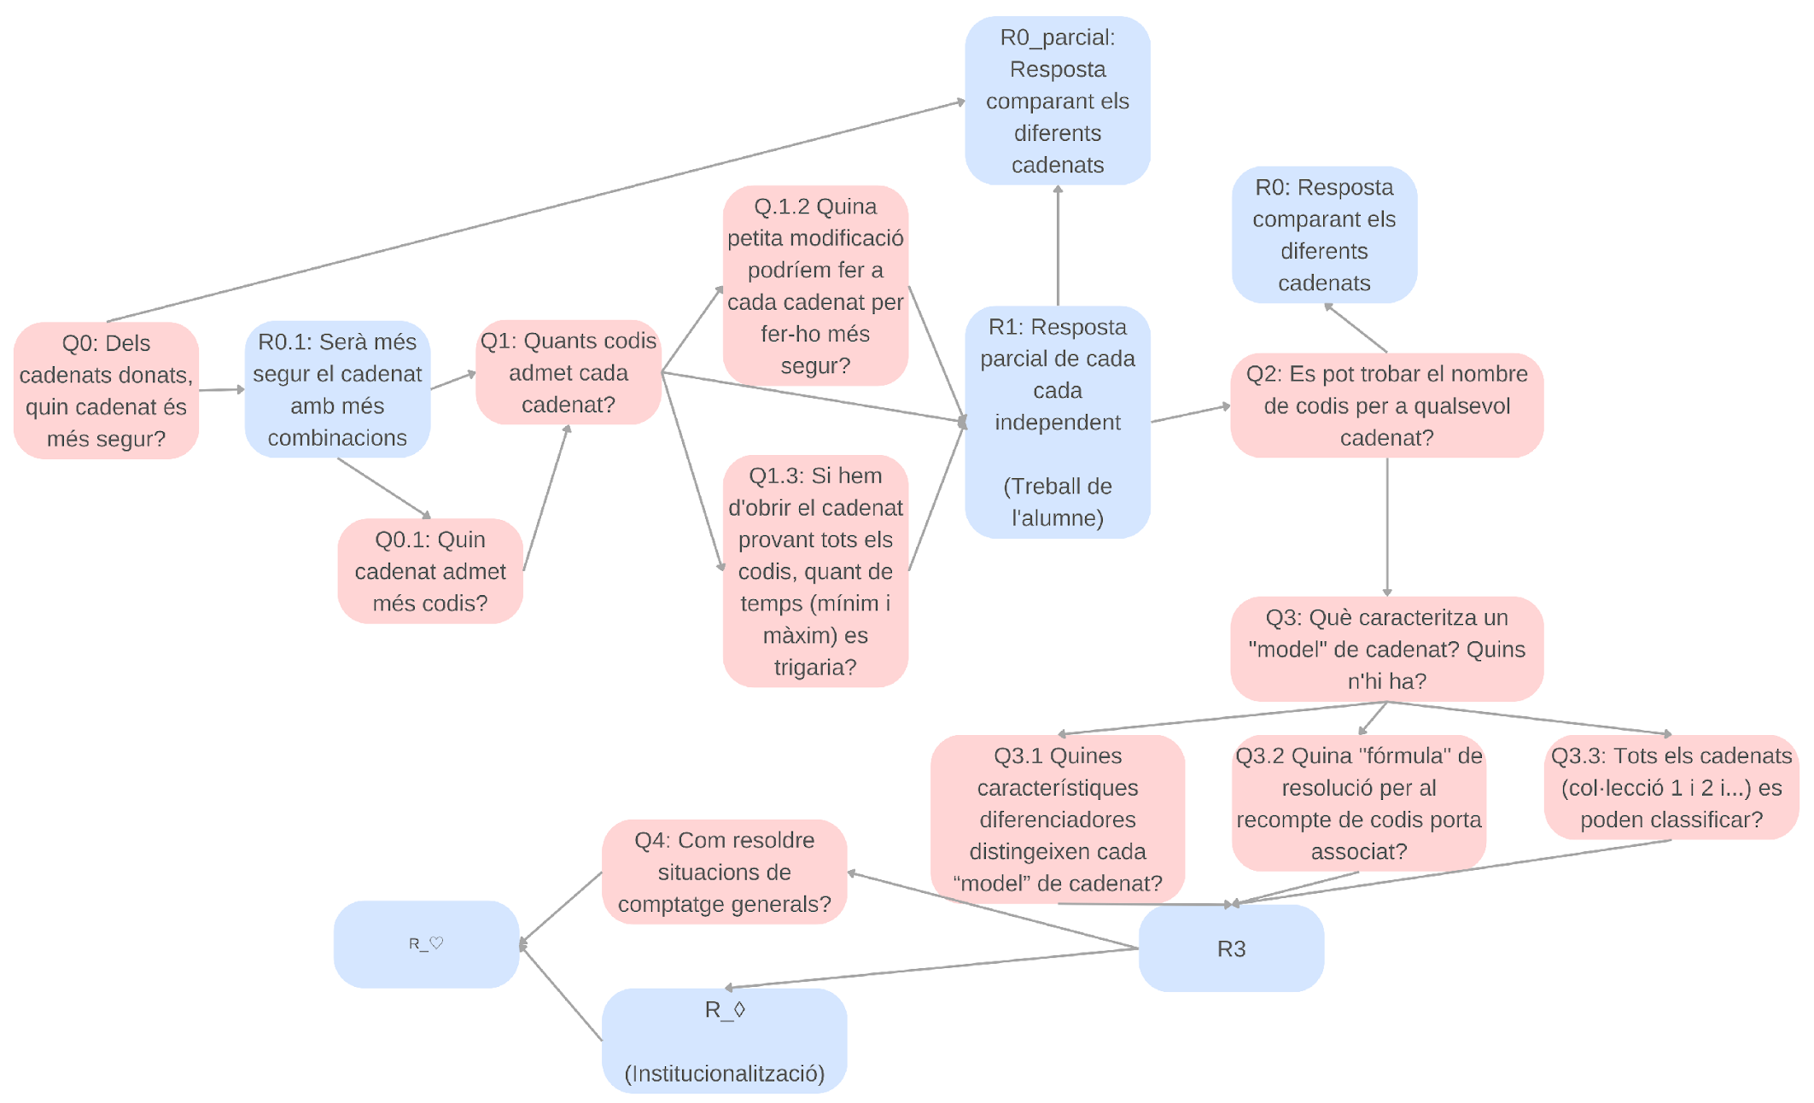
A priori map of possible developments of the situation
Notes:
You are unsure whether to include this one or another.
Susana, do you have any really cool maps that correspond to the second version of the REI? On which padlock is it more secure? Notice that the one included in Part 2 starts from another generative Q.

Slide 41
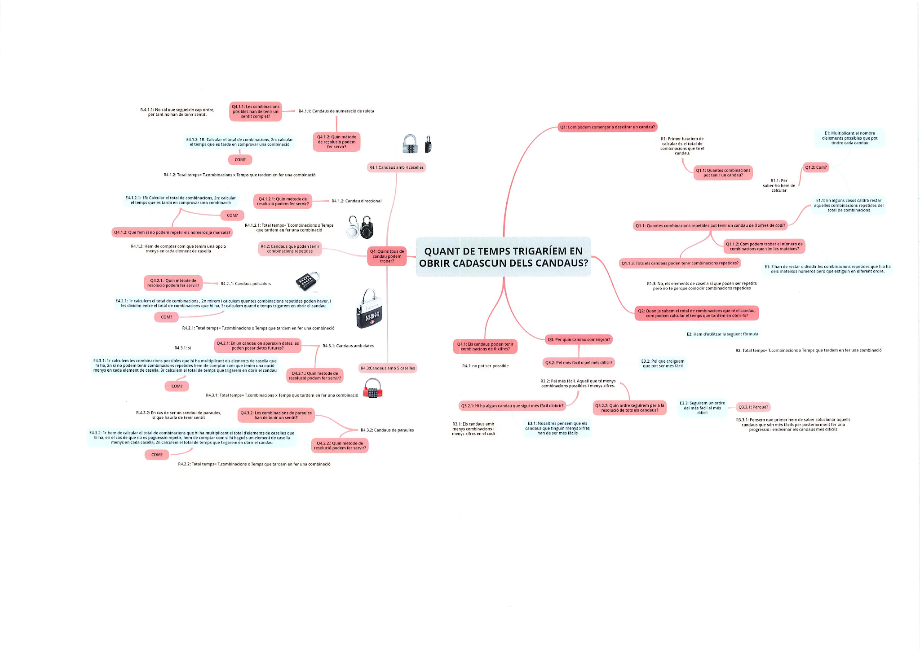
Left side of the map (zoom)
Notes:
You are unsure whether to include this one or another.

Slide 42
Right side of the map (zoom)
Notes:
You are unsure whether to include this one or another.

